Slide 1
EN 410 Energy Management
Gurubalan Annadurai
guru.a@iitb.ac.in

Slide 2
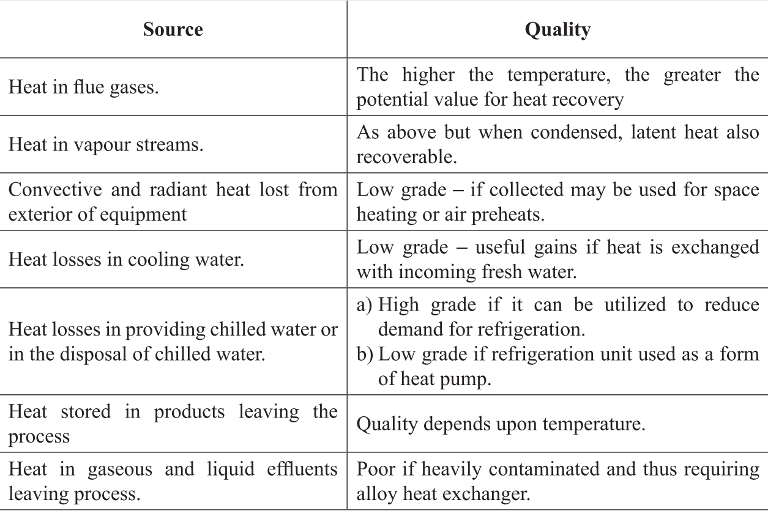
Heat Loss “Quality and Quantity”
Higher the temperature, higher the quality and most cost effective for recovery
Cascaded system is possible at high temperature , air preheating at high temperature and feed water heating at low temperature
Conditions of stream – vapor condensation, impurities

Slide 3
Types of Waste Heat Sources
Sources of waste energy are sometimes divided according to temperature into three temperature ranges:
- High temperature: > 650°C (1200°F)
- Medium temperature: 230°C < T < 650°C (450°F < T < 1200°F)
- Low temperature: < 230°C (450°F)
High and medium temperature waste heat can be used for power generation and steam production.
Low temperature waste heat can be used for steam and hot water production, process heating, space heating, and cooling applications.
High and medium temperature waste heat is usually the result of burning fuel in a combustion chamber where the flame temperatures can be as high as 2000°C (3600°F) or more.

Slide 4
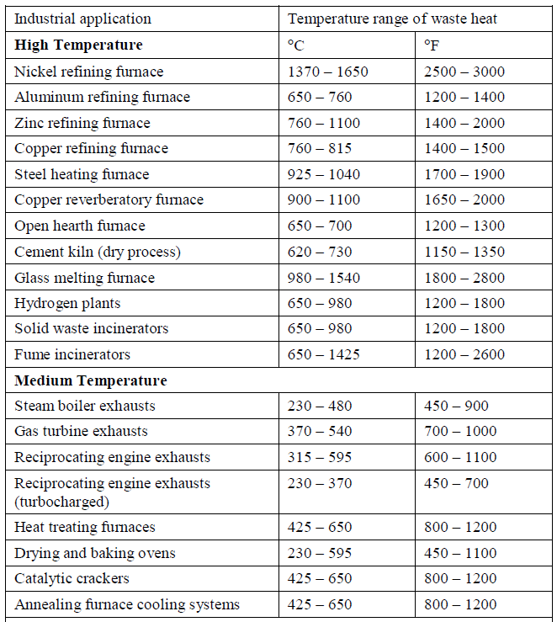
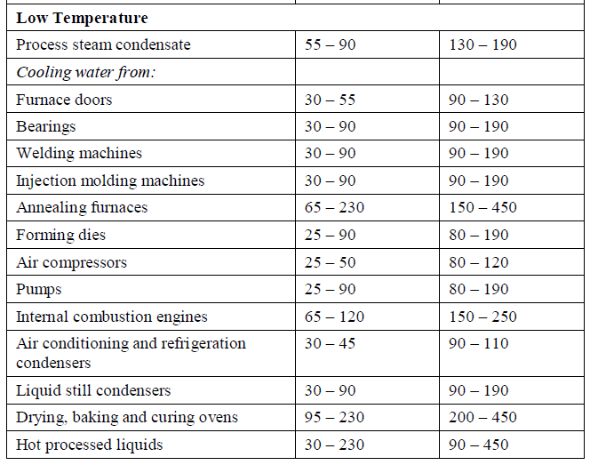
Types

Slide 5
Waste heat recovery
Benefits
Improving the efficiency of process
Reduction in pollution due to lesser use of fuel
Reducing the size of equipment and thereby reducing the size of auxiliary energy consumption
Process
Identify the source of waste heat
Availability of space
Any constrain such as condensation which leads to corrosion
Select the suitable HX
Economic evaluation

Slide 6
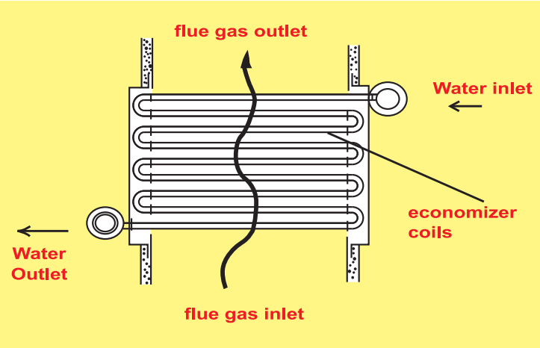
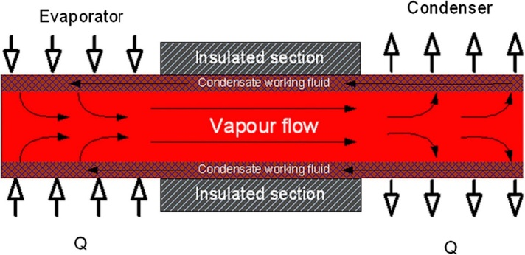
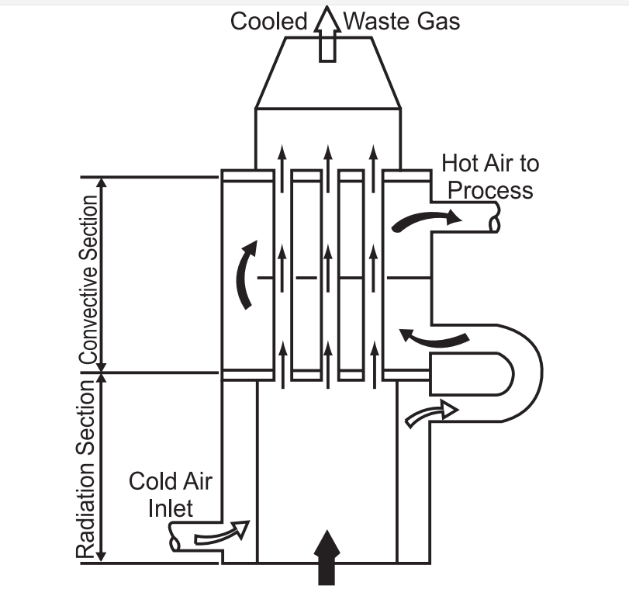
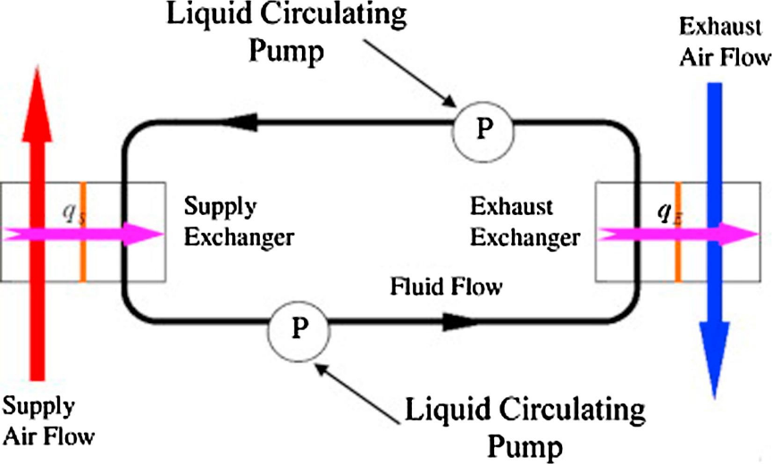
Types
Economizer
Heat pipe
Recuperator
Runaround coil loop

Slide 7
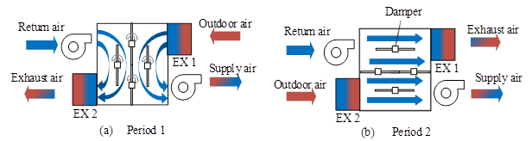
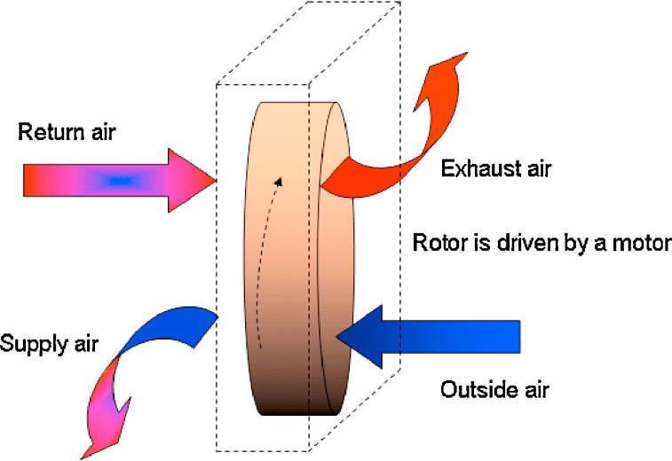
Types
Useful for larger application and at glass and steel melting furnaces
Fixed-bed regenerator
Rotary / Heat wheel

Slide 8
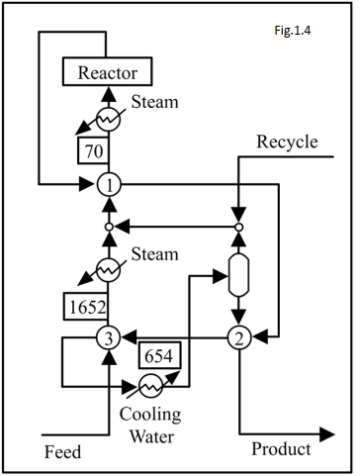
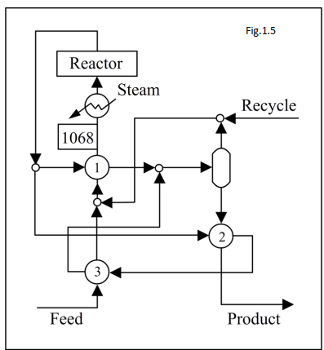
Pinch Technology
Methodology for minimizing the energy consumption by optimizing the heat recovery systems

Slide 9
Pinch Technology
 | Process stream type | Inlet temp | Outlet temp | Heat capacity rate | Q
 | - | ℃ | ℃ | kW/K | kW
1 | Cold | 90 | 420 | 10 | 3300
2 | Cold | 170 | 350 | 32 | 5760
3 | Cold | 200 | 390 | 29 | 5510
4 | Hot | 440 | 140 | 27 | 8100
5 | Hot | 510 | 300 | 24 | 5040
Find out the heating and cooling requirements?

Slide 10
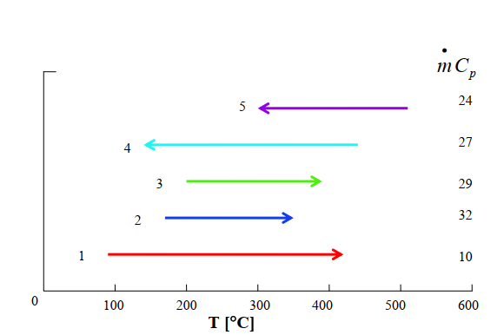
Temperature interval of streams

Slide 11
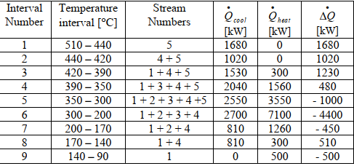
External heating and cooling requirements

Slide 12
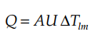
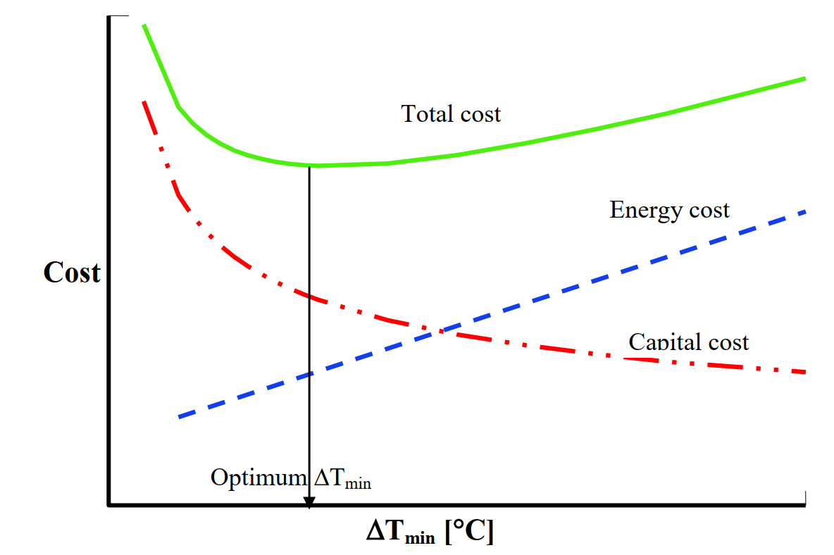
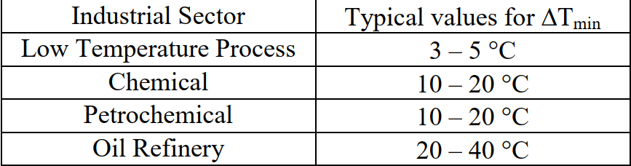
Minimum temperature difference
Higher the ΔT lesser the area, lesser the heat recovery, larger the external utilities
Vice versa

